Slide 1


Social Buzz’s
Company

Slide 2


Agenda
Project recap
Problem
The Analytics team
Process
Insights
Summary

Slide 3


jkrfnzejdfrzrefzjnhdrf
Social Buzz is a fast growing technology unicorn that needs to adapt quickly to its global scale.
Accenture has begun a 3 months POC focusing on these tasks:
An audit of Social Buzz’s big data practice
Recommendations for a successful IPO
Analysis to find Social Buzz’s top 5 most popular categories of content
Project Recap

Slide 4


Problem
Over 100000 posts per day
63,500,00 pieces of content
per year!
But how to capitalize on it when there is so much?
Analysis to find Social Buzz’s top 5
categories of content

Slide 5




Chakir Fatima Ez-zahra
Data Analyst
The Analytics team
Marcus Rompton
Senior Principle
Andrew Fleming
Chief Technical Architect

Slide 6

Exploratory Data Analysis (EDA)
Process
1
2
Data Cleaning
3
Data Modeling
4
Data Analysis
5
Insights & Decision Making

Slide 7
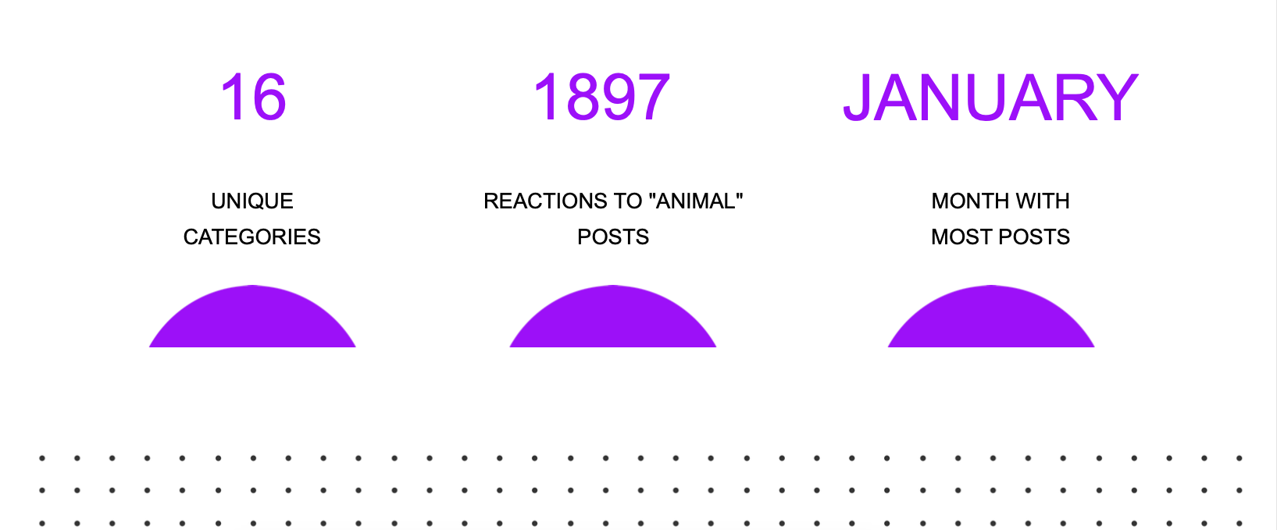


Insights

Slide 8
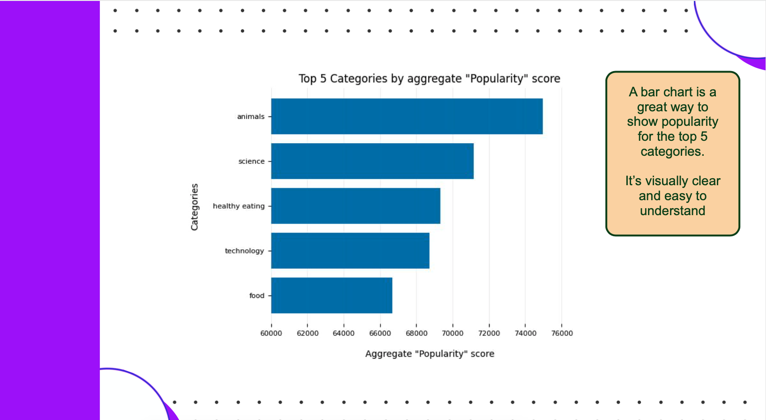

Slide 9
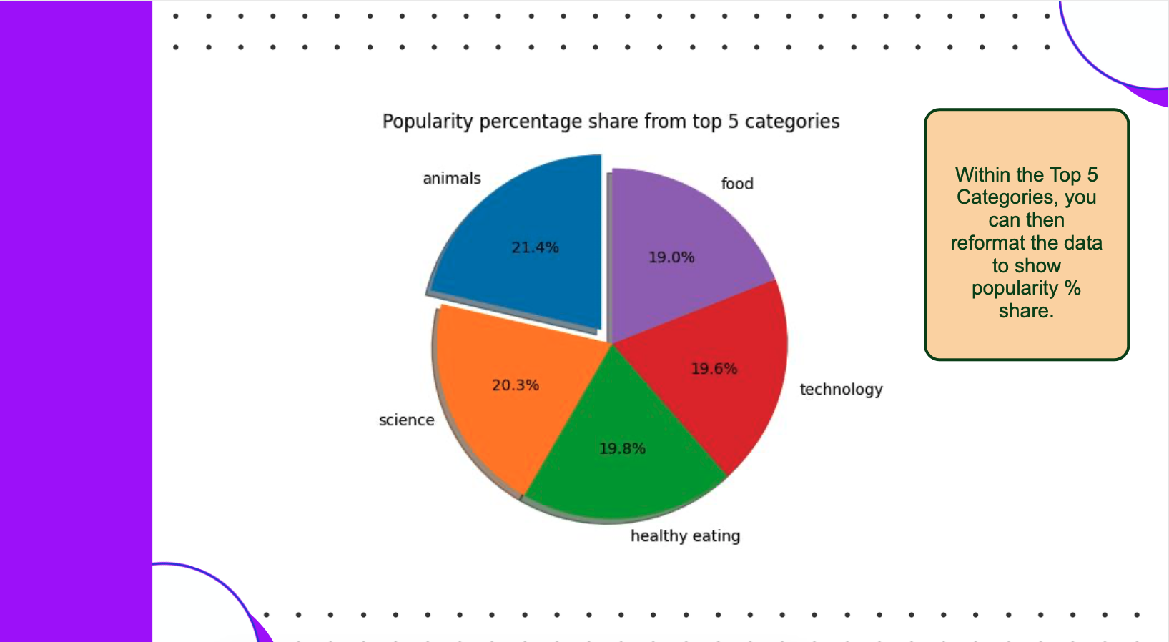

Slide 10


Summary

Slide 11

Thank you!
ANY QUESTIONS?

